Slide 1

EDW PROJECT INSTALLATION

Slide 2
1
Setup PyCharm
2
Setup Git Repos
3
Introduce to Airflow framework
4
How to create and manage DAG in Airflow

Slide 3
Download and installation
Setup PyCharm
1
Download PyCharm Community Edition:
Head over to the official JetBrains website and find the PyCharm Community Edition.
Download the latest version suitable for your operating system (Windows, macOS, or Linux).
Install PyCharm Community Edition:
Once the download is complete, locate the downloaded file (usually in your “Downloads” folder).
Double-click on the downloaded file to start the installation process.
Follow the installation prompts to complete the setup.
Launch PyCharm Community Edition:
After installation, you can launch PyCharm Community Edition from your applications menu or desktop shortcut.

Slide 4
1
Setup PyCharm
2
Setup Git Repository
3
Introduce to Airflow framework
4
How to create and manage DAG in Airflow

Slide 5
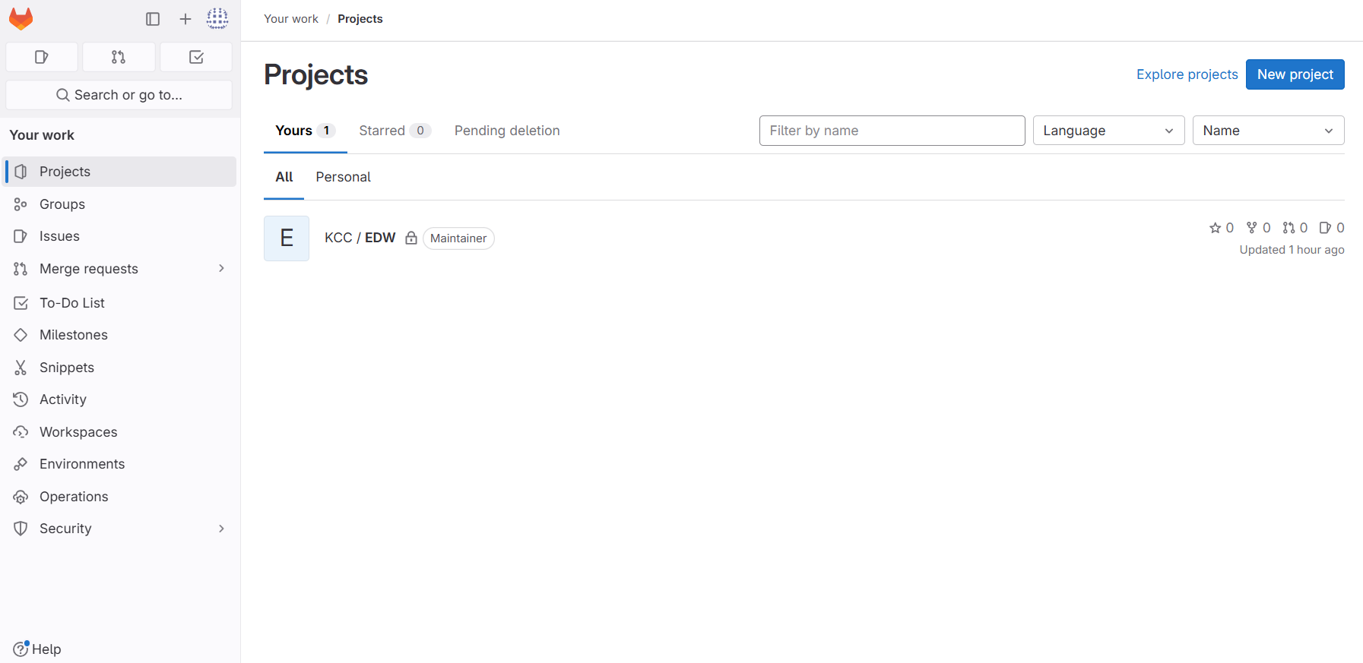
LOGIN to GIT REPOSITORY go to project EDW
2
Setup Git Repository

Slide 6
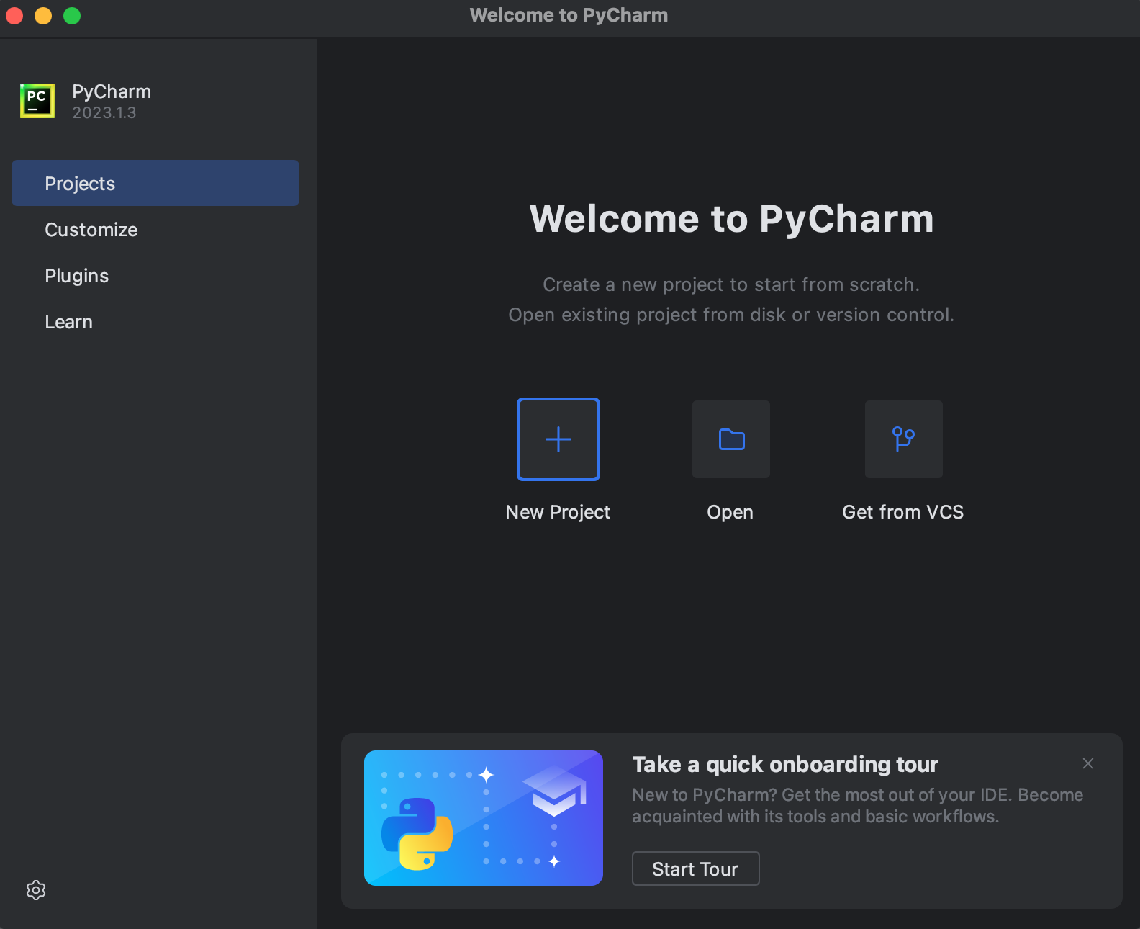
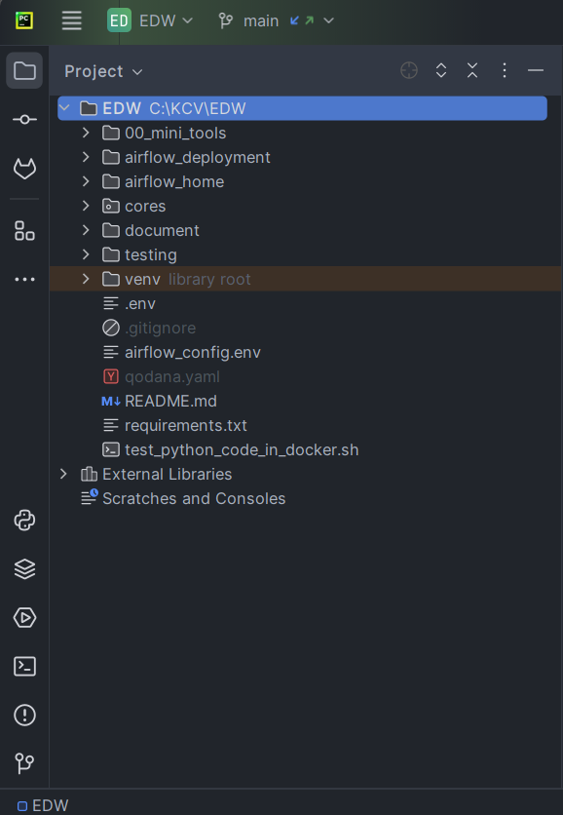
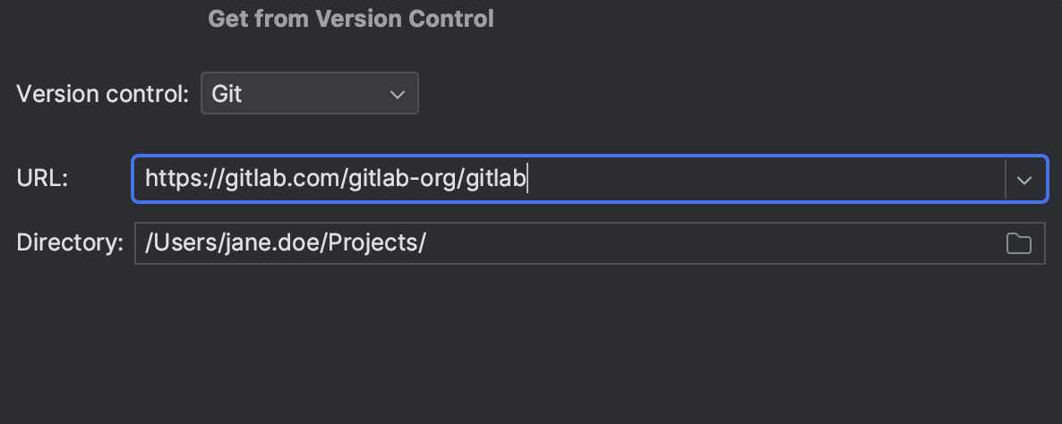
2
Setup Git Repository
Before cloning a project, make sure you have logged in to your GitLab account.
Use one of the options to open the Get from Version Control dialog:
Go to File | New | Project from Version Control.
If you already have a project open, go to VCS | Get from Version Control.
On the Welcome screen, click the Get from VCS button.
Specify the URL of the project you want to clone (EDW GitLab URL below).
In the Directory field, enter the path to the folder where your local Git project will be created.
Click Clone.
EDW GitLab: https://gitlab.com/kcc9725208/EDW.git

Slide 7
1
Setup PyCharm
2
Setup Git Repository
3
Introduce to Airflow framework
4
How to create and manage DAG in Airflow

Slide 8
What is airflow?
3
Introduce to Airflow framework
Apache Airflow is an open-source platform designed for developing, scheduling, and monitoring batch-oriented workflows.
Workflows as Code:
In Airflow, all workflows are defined using Python code. This approach has several benefits:
Dynamic: Airflow pipelines can be dynamically generated using Python code.
Extensible: Airflow components (called operators) can connect with various technologies, and the framework is easily extensible.
Flexible: Workflow parameterization is built-in using the Jinja templating engine.

Slide 9
DAGs (Directed Acyclic Graphs)
3
Introduce to Airflow framework
A DAG represents a workflow in Airflow.
It consists of individual tasks (pieces of work) arranged with dependencies and data flows.
Tasks are defined as operators (e.g., BashOperator, PythonOperator).
Dependencies between tasks define the execution order.

Slide 10
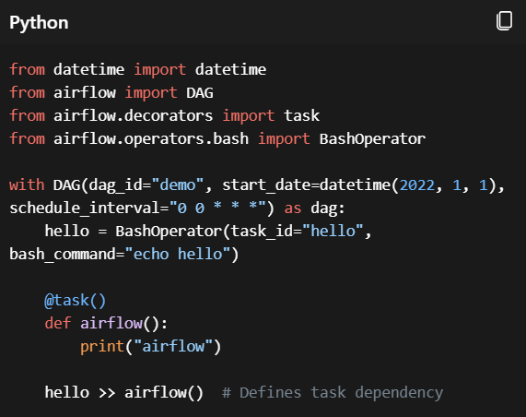
Example DAG
3
Introduce to Airflow framework
This example:
Creates a DAG named “demo” starting on Jan 1, 2022, running daily.
Includes two tasks: a BashOperator and a Python function.
The >> operator defines the dependency between tasks.

Slide 11
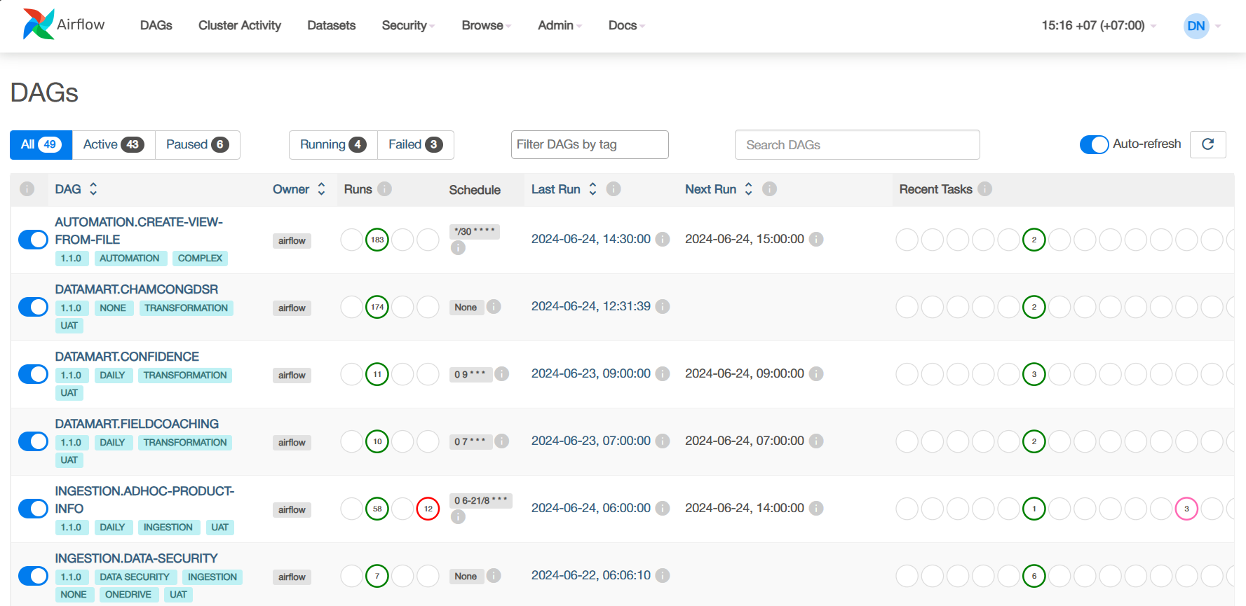
Web Interface
3
Introduce to Airflow framework
Airflow provides a web interface to monitor, trigger, rerun, and debug tasks and DAGs.
You can view the status of your workflows and explore DAG runs over time.

Slide 12
Key Features of the Airflow UI
3
Introduce to Airflow framework
DAGs View:
Lists all the DAGs in your environment.
Provides shortcuts to useful pages.
Shows task statuses (succeeded, failed, running).
Cluster Activity View:
Collects metrics for monitoring your Airflow cluster.

Slide 13
Accessing the Airflow UI
To access the Airflow UI, open your web browser and visit http://118.68.171.160:8080/.
Log in using the provided account details (in Project Plan Excel file).

Slide 14
1
Setup PyCharm
2
Setup Git Repository
3
Introduce to Airflow framework
4
How to create and manage DAG in Airflow

Slide 15
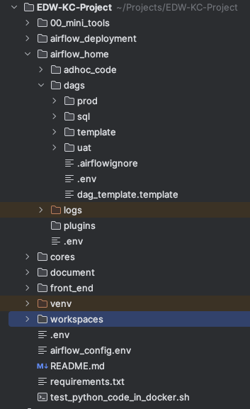
4
How to create and manage DAG in Airflow
Contain CLI code of mini tool (e.g. repartition, backup data to parquet…)
Current project structures:
Contain code for deploy project
Contain adhoc code using to move data from old db to new one
Contain DAG files (pipelines), each dag file should be unique in both directory (production + uat)
Contain .sql file contain sql for transform data
Cores of framework, written in python, integrated with airflow
Virtual environment of python, pycharm will ask to install first time open project after clone from git (detect requirements.txt…)

Slide 16
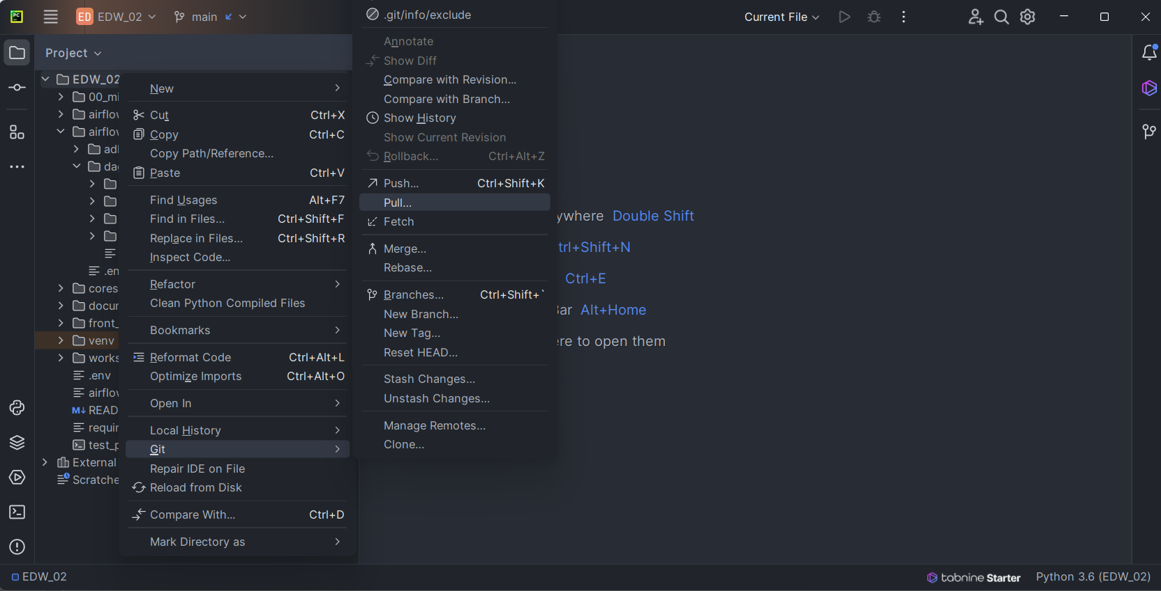
4
How to create and manage DAG in Airflow
Before adding new or changing, make sure the update is the latest
Right click on project -> Git -> Pull…

Slide 17
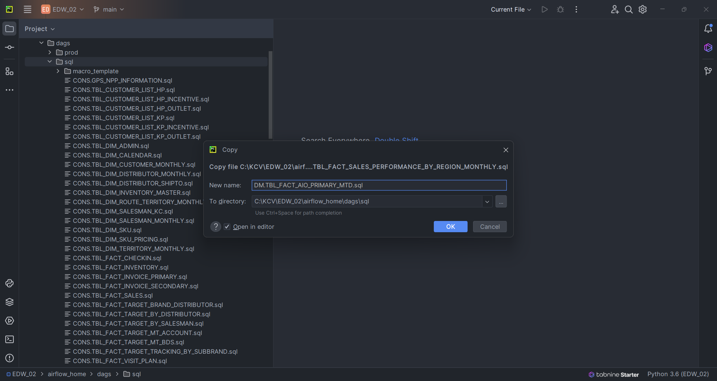
4
How to create and manage DAG in Airflow
Add sql statements via file under sql folder, so that DAG tasks can be called and executed at runtime

Slide 18
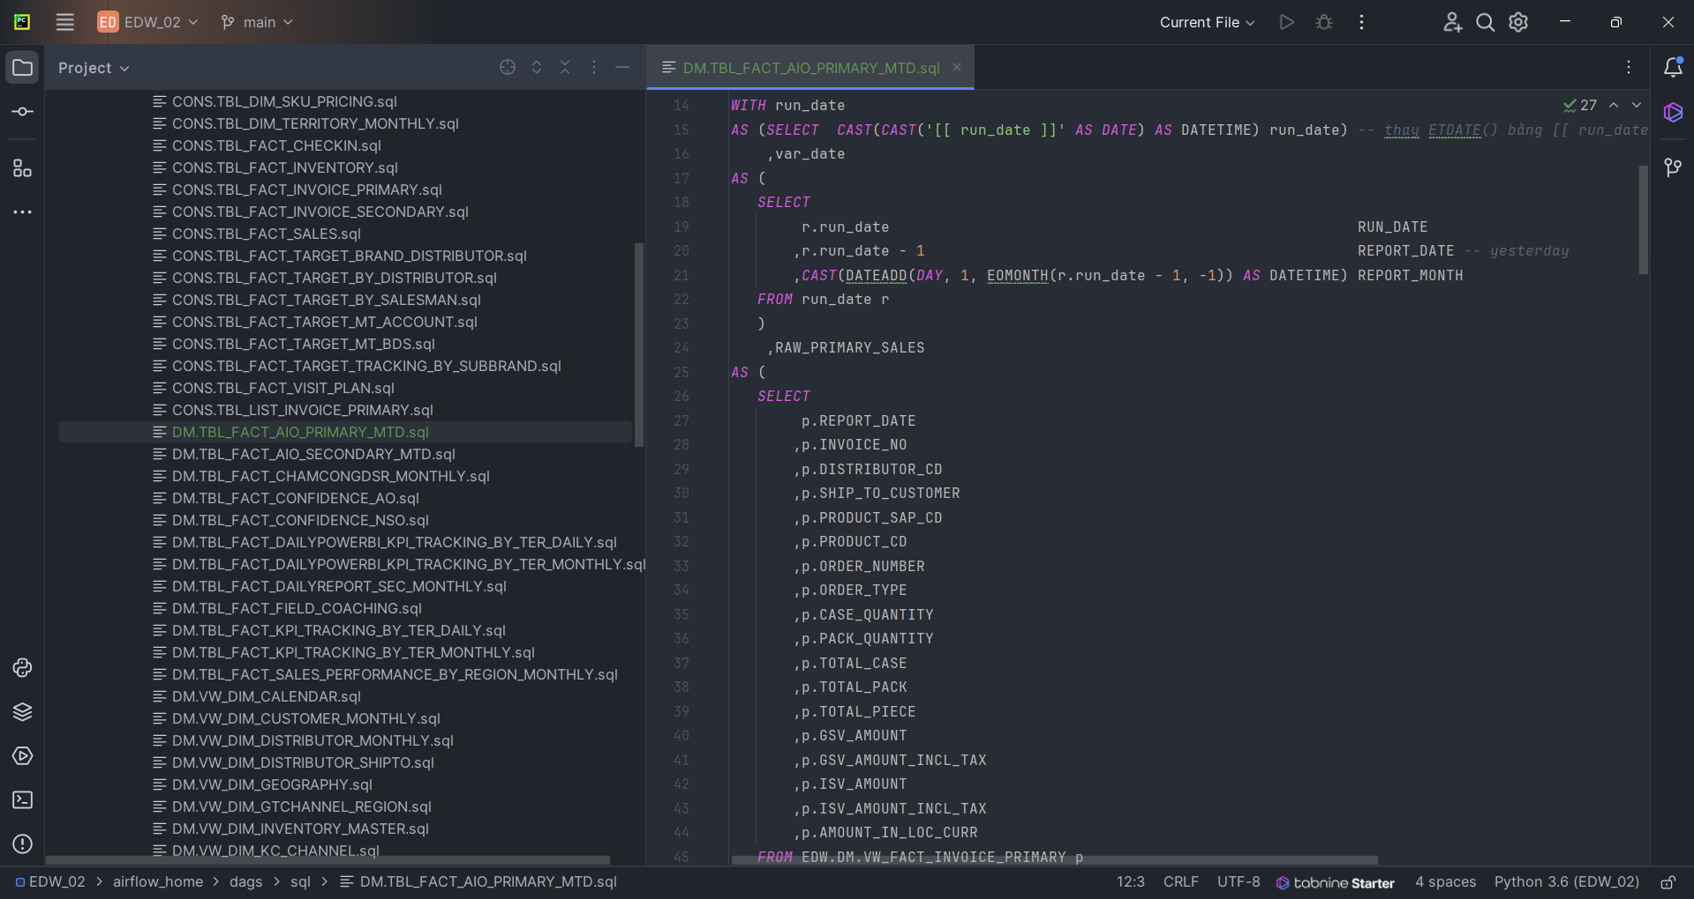
4
How to create and manage DAG in Airflow
Remember to update the optional parameter [[ run_date ]] (with single quote) replace for all call to function getdate()

Slide 19
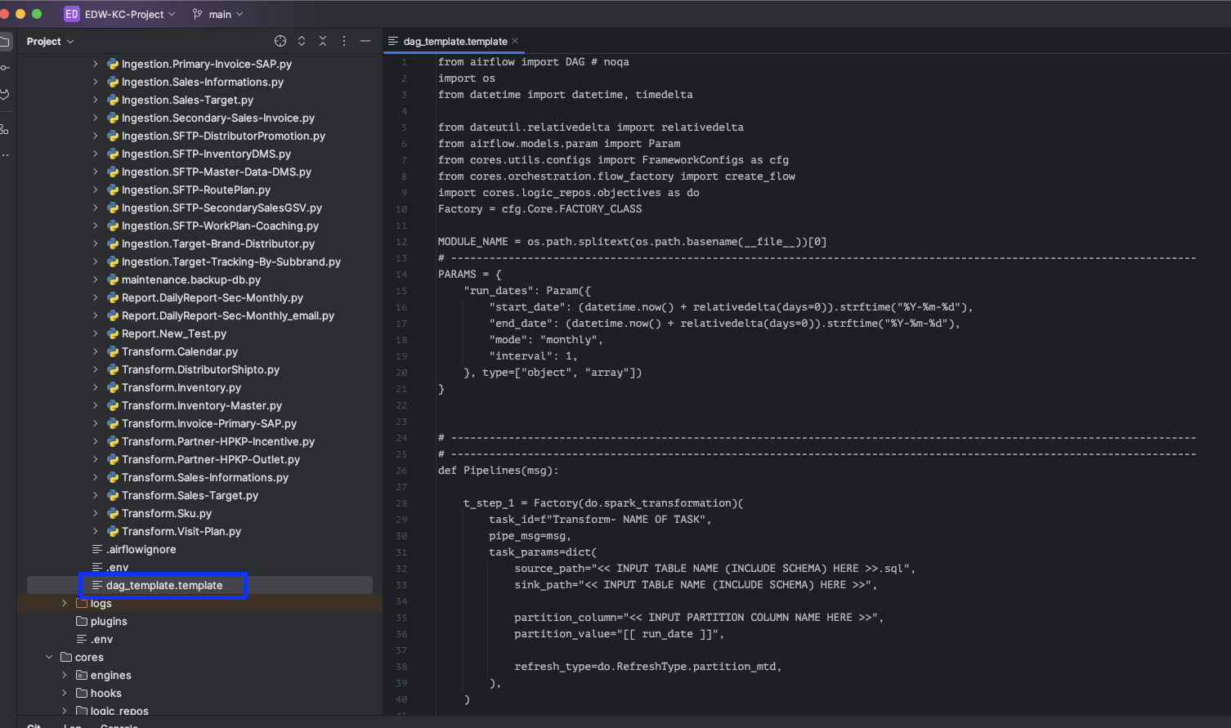
4
How to create and manage DAG in Airflow
Add a DAG file (.py) under uat/prod folder, copy standard template from:
/EDW/airflow_home/dags/dag_template.template
When pipeline is under testing, put it in uat, when it is stable, move to prod folder

Slide 20
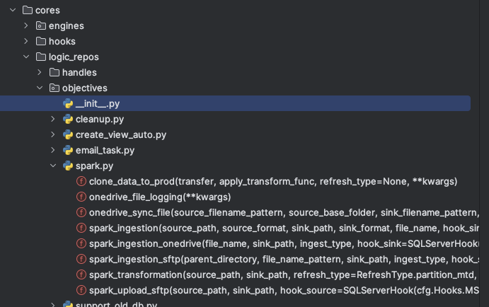
4
How to create and manage DAG in Airflow
Inside Factory class, we call to function defined in directory Objectives (right screenshot)
Define of 3 main functions below:
spark_ingestion_sftp:
Parameters:
parent_directory and file_name_pattern: Directory and pattern for the SFTP files.
sink_path: Path for the sink data.
ingest_type: Type of ingestion (e.g., MTD, CDC).
hook_sink: Hook to connect to the sink database.
batch_size: Maximum number of files to ingest per run.
sftp_conn_id: ID for the SFTP connection.
transform_callables: List of transformation functions to apply.
spark_transformation:
Parameters:
source_path and sink_path: Paths for the source and sink data.
refresh_type: Type of data refresh (default is partition_mtd).
source_format: Formats of the source data.
Type of source format support: mssql, csv, txt, excel, xlsb, xlsx, parquet, dataframe.
sink_format: Formats of the sink data.
Type of sink format support: mssql, parquet, csv.
hook_source and hook_sink: Hooks to connect to the source and sink databases.
transform_callables: List of transformation functions to apply.
spark_ingestion_onedrive:
Parameters:
file_name and sink_path: Name of the file and path for the sink data.
ingest_type: Type of ingestion.
hook_sink: Hook to connect to the sink database.
sink_format: Format of the sink data.
transform_callables: List of transformation functions to apply.
partition_column and partition_value: Partitioning details for data cleaning.

Slide 21
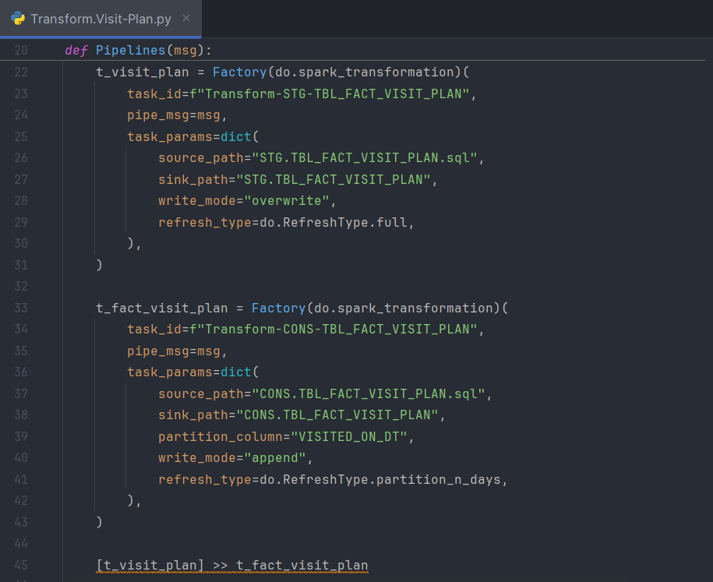
TASK Dependencies
4
How to create and manage DAG in Airflow
What Are Task Dependencies?
Task dependencies define the relationships between tasks within a DAG.
Each task can have:
Upstream tasks: Tasks that must complete before the current task can run.
Downstream tasks: Tasks that depend on the current task’s completion.
Declaring Task Dependencies:
You can declare task dependencies using two main approaches:
a. Using >> and << Operators:
The recommended way is to use the >> and << operators.
Example:
first_task >> [second_task, third_task]
third_task << fourth_task

Slide 22
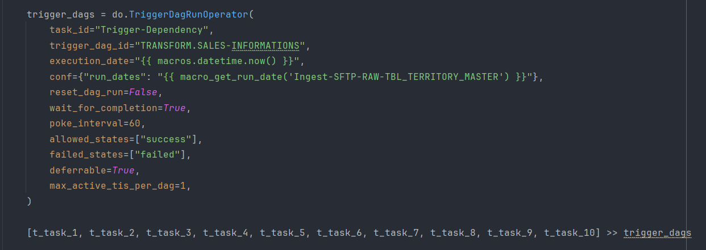
Cross-DAG Dependencies
4
How to create and manage DAG in Airflow
Cross-DAG dependencies arise when one DAG relies on the successful execution of tasks in another DAG.

Slide 23
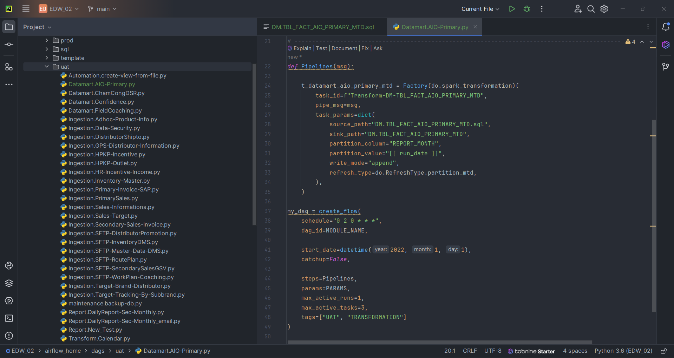
SCHEDULE A DAG
4
How to create and manage DAG in Airflow
To schedule a DAG run, using Cron Expressions:
A cron expression defines a schedule using fields for minute, hour, day of the month, month, and day of the week.
For example, "0 2 0 * * *" means the DAG runs every day at 2:00 AM.
Cron Expression Examples - Crontab.guru

Slide 24
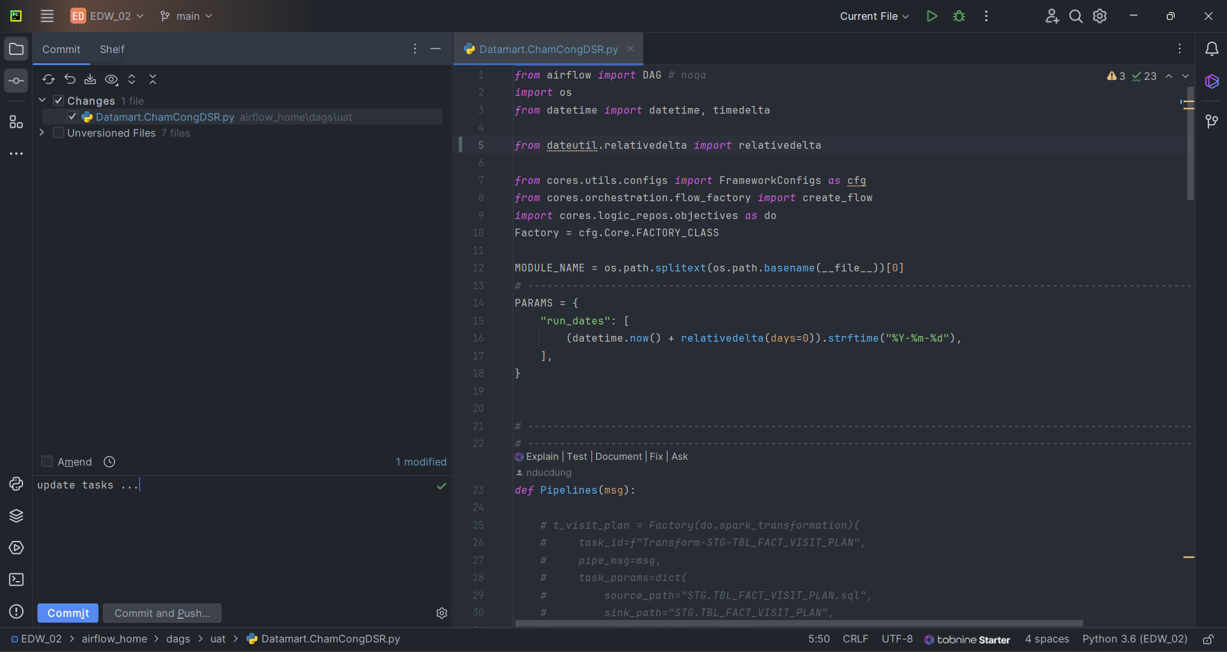
DEPLOY DAGs TO AIRFLOW
4
How to create and manage DAG in Airflow
We can deploy by 2 ways
To deploy a DAG, go to Git -> Commit File …
Go to Commit tab to selected files to commit

Slide 25
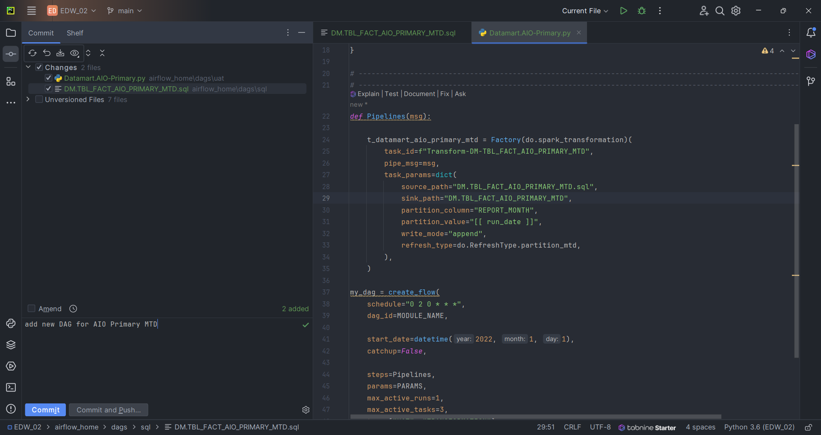
DEPLOY DAGs TO AIRFLOW
4
How to create and manage DAG in Airflow
Add description about code
Commit and Push …

Slide 26
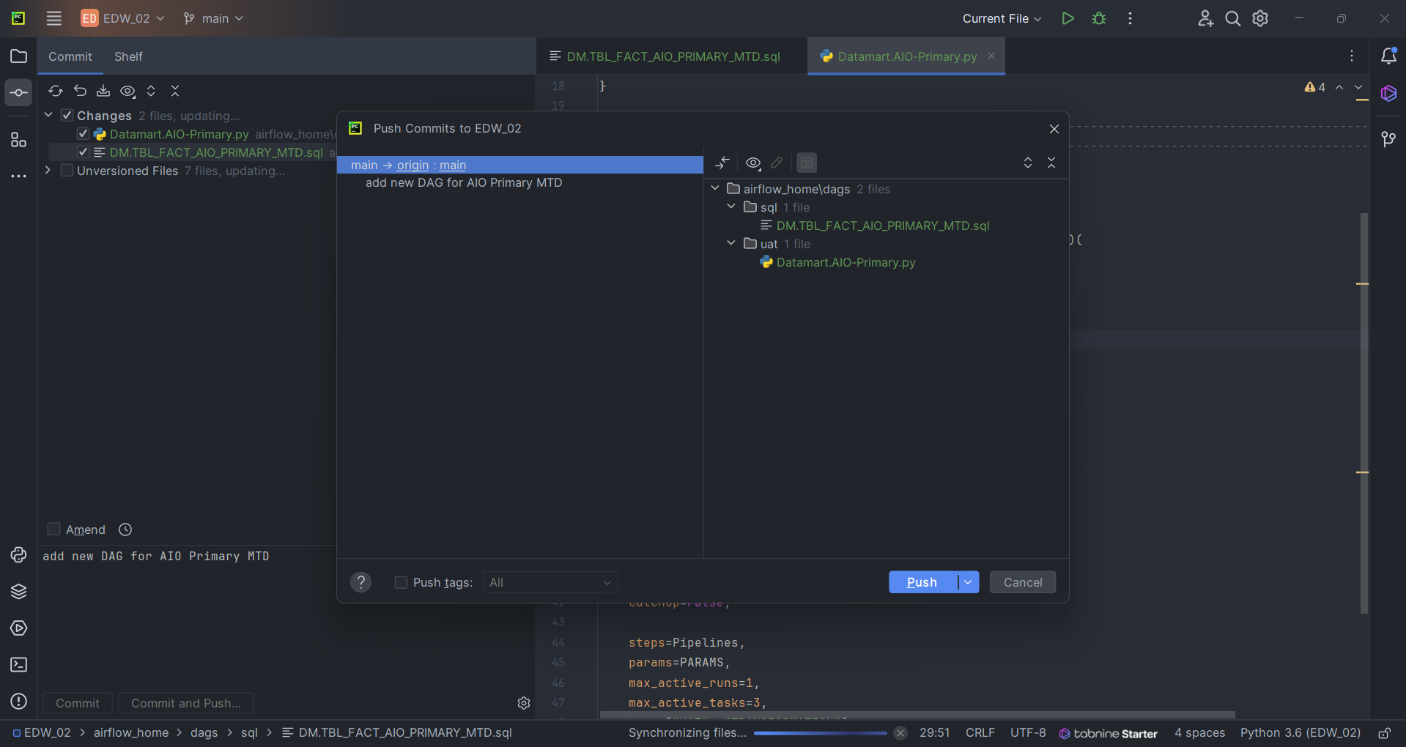
DEPLOY DAGs TO AIRFLOW
4
How to create and manage DAG in Airflow
Click Push button to complete the deployment

Slide 27
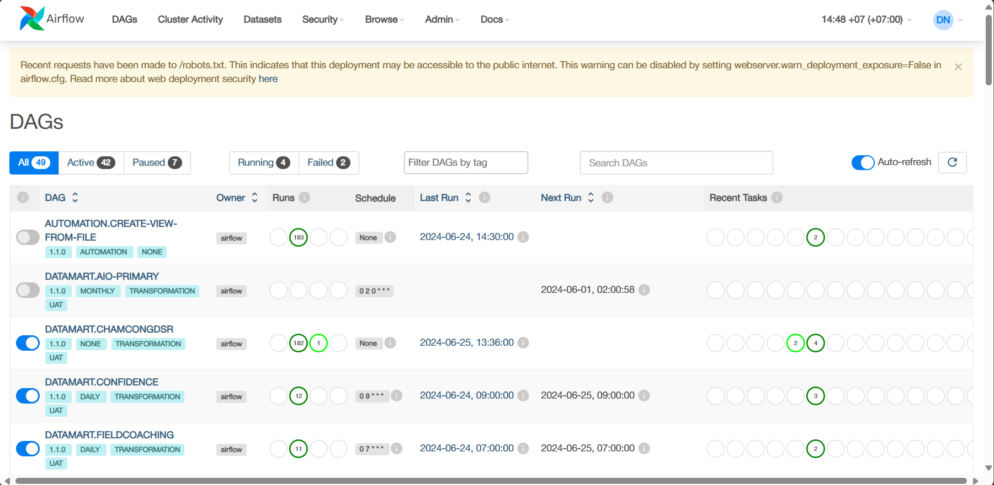
DEPLOY DAG INTO AIRFLOW
4
How to create and manage DAG in Airflow
Go to Airflow web application
The deployed DAG will be appeared in the DAGs list
The DAGs can be run by scheduled time or manual.

Slide 28
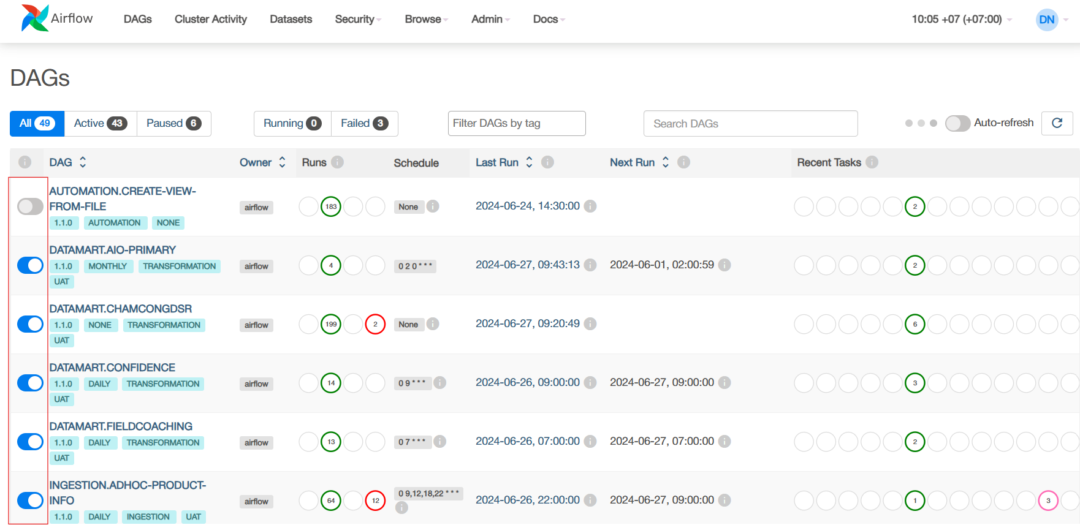
Enable/disable dags
4
How to create and manage DAG in Airflow
Enable / Disable Toggle button to make DAGs runnable

Slide 29
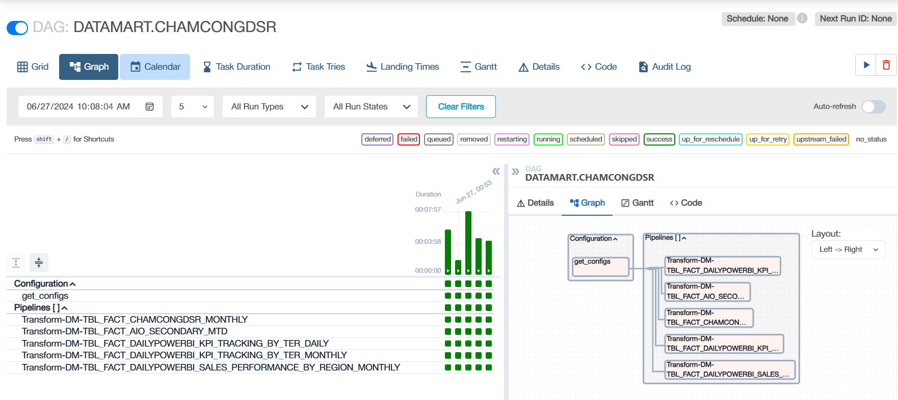
Monitor the dags run
4
How to create and manage DAG in Airflow
Click on the DAG name to go to monitor screen
All tasks of the DAG can be monitored in the screen

Slide 30
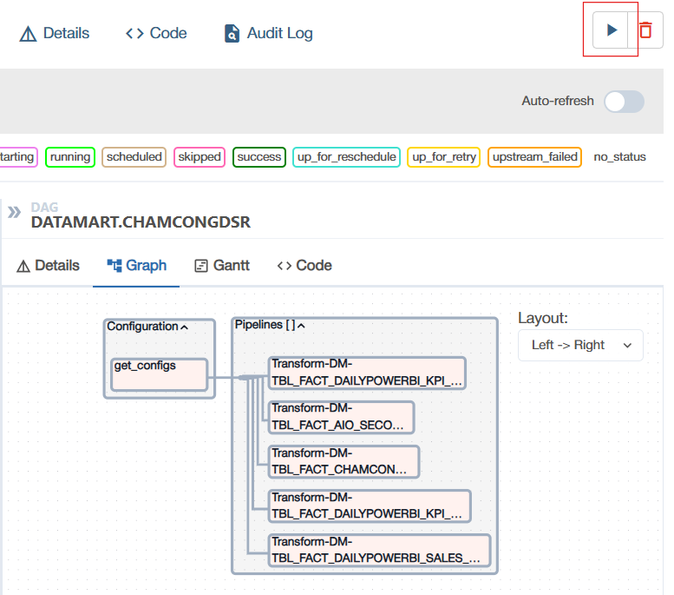
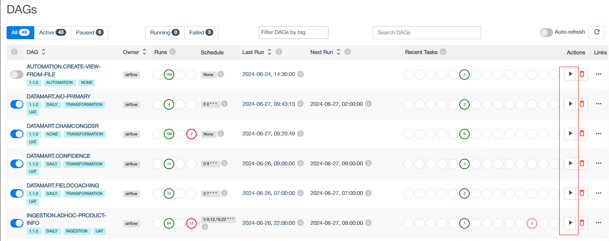
Manual run DAG
4
How to create and manage DAG in Airflow
To run DAGs by specific run_date -> click the run icon

Slide 31
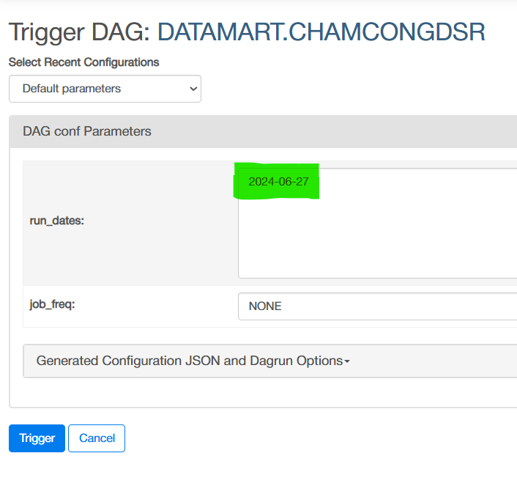
Manual run DAG
4
How to create and manage DAG in Airflow
To run 1 or more dates, enter the list of dates in DAG conf parameters with run_dates
Click Trigger to run the DAG

Slide 32
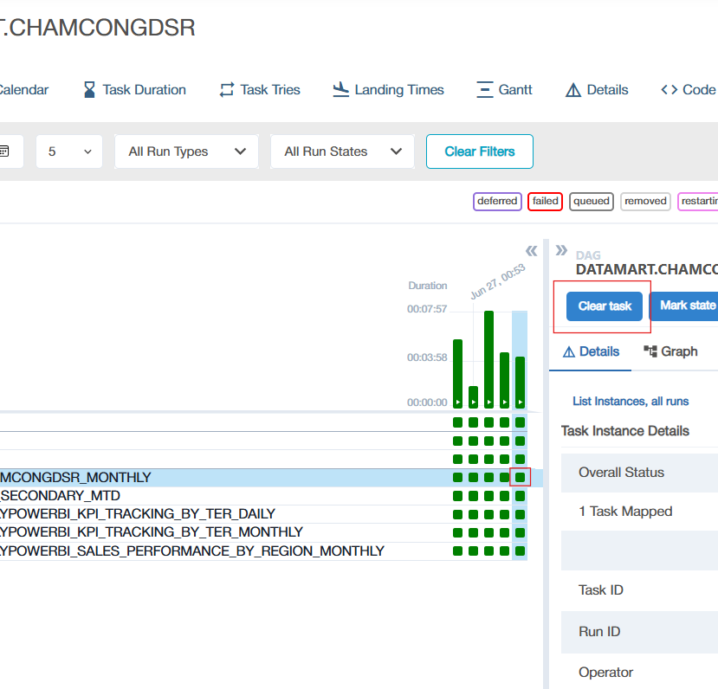
Re-run tasks
4
How to create and manage DAG in Airflow
To re-run specific tasks, click on the task and click clear button to re-run the task

